Slide 1
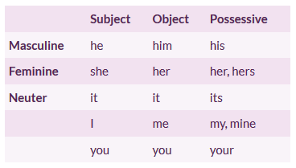
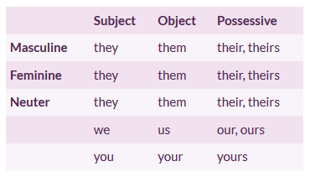
Personal pronouns: Putting it all together
A personal pronoun is a word that replaces a noun in a sentence.
Deciding what pronoun to use
Match the number (singular or plural), gender (masculine, feminine, neuter), and form (subject, object, possessive) of the noun you are replacing.
Singular pronouns
Plural pronouns
Examples:
Singular feminine subject
Jennifer texts on her phone all day. She even texts at the beach.
Singular neuter object
I parked the car in huge parking lot. Now I can’t find it.
Singular masculine possessive
I forgot John’s address. I knew his address yesterday.
Plural mixed gender subject
John and Jennifer walked to the car. They remembered where it was.
Plural masculine possessive
We couldn’t find Carl and Ming’s keys. We looked everywhere for their keys.
Using I or me in a sentence: Use I for the subject and me for the object. Name yourself second!
Naming yourself as a subject
She and I went to the movies.
To decide if you have chosen the right pronoun, try leaving the other pronoun out of the sentence and see if it sounds correct.
Naming yourself as an object
The boss thanked Jen and me for our work.
Replacing singular nouns when you don’t know the gender: Do not use their
Three different options:
Use both his and her
Anybody could have his or her identity stolen.
Do not use THEIR because the subject is singular.
The employee should submit his or her report each week.
Use one pronoun, either masculine or feminine
The employee should submit her report each week.
Rewrite the sentence to make the subject plural
Employees should submit their reports each week.

